Slide 1
Many to Many MSBA BAN 6020 Data Management
Carolina Salge

Slide 2
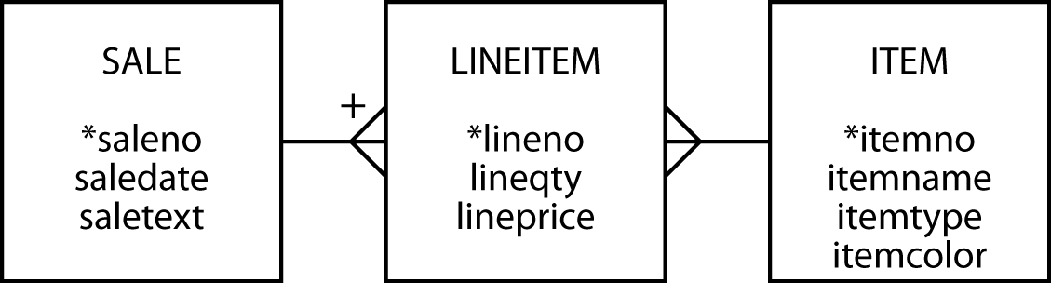
Many to Many
Create a third entity to map a M:M
An associate or weak entity
The + indicates that LINEITEM is identified by concatenating saleno and lineno
LINEITEM is known as a weak entity, and it has an identifying relationship with SALE

Slide 3
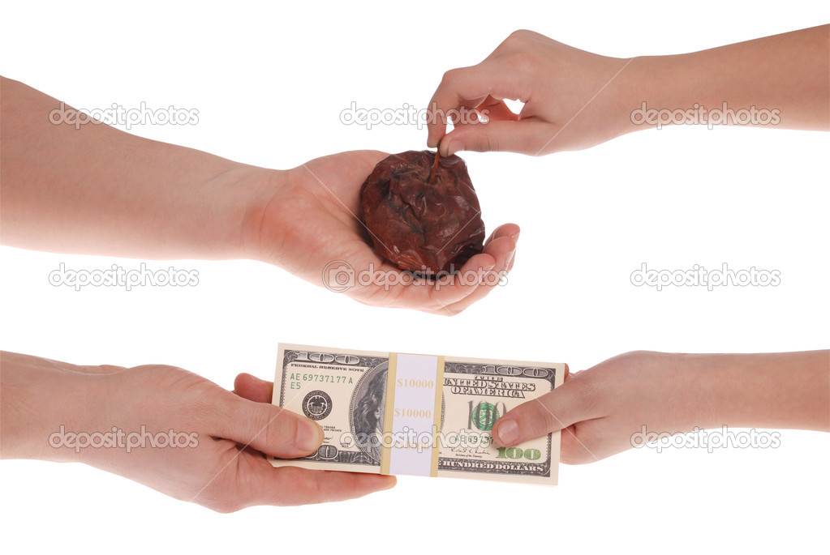
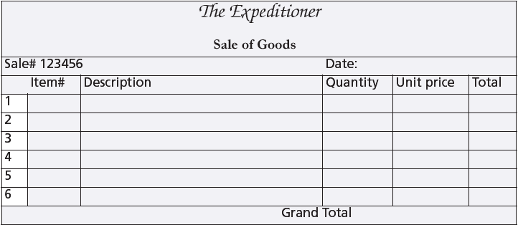
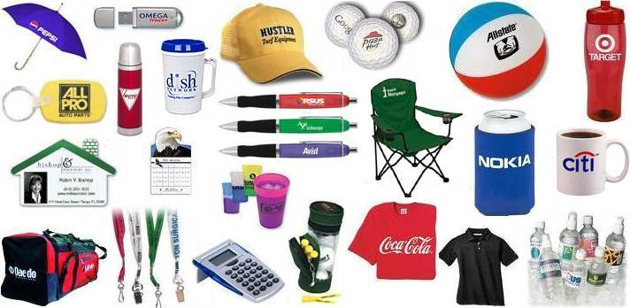
Many to Many

Slide 4
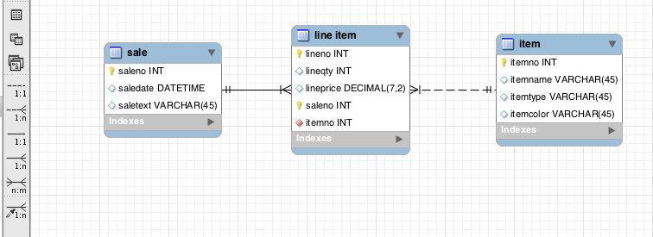
MySQL Workbench
Identifying
relationship
Non-identifying
relationship
m:m symbol

Slide 5
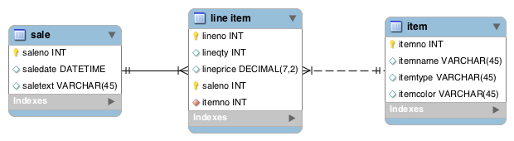
Two Notations, Equivalent Models

Slide 6
Why Third Entity
Cannot store items sold in sale because a sale can have many items, and an instance of an entity stores only single-value facts. Same applies the other way around—tidy data, remember?
Notes:
Cannot store sale data in item because an item can appear in many sales

Slide 7
M:M = 1:M + 1:M
One item can be on many line items, but one line item entry refers to only one item
One sale can have many line items, but one line item entry refers to only one sale

Slide 8
Mapping Database
Same rules apply
Associative entity has two FKs
A FK can also be part of the PK
lineitem
lineno | lineqty | lineprice | saleno | itemno
1 | 1 | 4.50 | 1 | 2
1 | 1 | 25.00 | 2 | 6
2 | 1 | 20.00 | 2 | 16
3 | 1 | 25.00 | 2 | 19

Slide 9
Define a Table
create table sale (
saleno integer,
saledate date not null,
saletext varchar(50),
primary key(saleno));
create table item (
itemno integer,
itemname varchar(30) not null,
itemtype char(1) not null,
itemcolor varchar(10),
primary key(itemno));
create table lineitem (
lineno integer,
lineqty integer not null,
lineprice decimal(7,2) not null,
saleno integer,
itemno integer,
primary key(lineno, saleno),
constraint fk_has_sale foreign key(saleno) references sale(saleno)),
constraint fk_has_item foreign key(itemno) references item(itemno));

Slide 10
Exercise
A keen field hockey fan wants to keep track of which countries won which medals in the various summer Olympics for both the men’s and women’s events
Design a data model
http://en.wikipedia.org/wiki/Field_hockey_at_the_Summer_Olympics

Slide 11
Three Table Join
List the names of the three tables after from
Specify two matching conditions with the associative table in both join conditions
select * from sale, lineitem, item
where sale.saleno = lineitem.saleno
and item.itemno = lineitem.itemno;

Slide 12
Three Table Join
List the name, quantity, and value of items that were sold on January 16 of 2011
select itemname, lineqty, lineprice, lineqty*lineprice as total from sale, lineitem, item
where sale.saleno = lineitem.saleno
and item.itemno = lineitem.itemno
and saledate = '2011-01-16';
itemname | lineqty | lineprice | total
Pocket knife—Avon | 1 | 0.00 | 0.00
Safari chair | 50 | 36.00 | 1800.00
Hammock | 50 | 40.50 | 2025.00
Tent—8 person | 8 | 153.00 | 1224.00
Tent—2 person | 1 | 60.00 | 60.00

Slide 13
Note to Carolina
Stop here! Finish chapter 5 next class

Slide 14
Exists
Used in the where clause to test whether at least one row satisfies a certain condition
Report all clothing items (by name and color) of type ‘C’ for which a sale is recorded
select itemname, itemcolor from item
where itemtype = 'C'
and exists (select * from lineitem where item.itemno = lineitem.itemno);

Slide 15
Exists
select itemname, itemcolor from item where itemtype = 'C'
and exists (select * from lineitem where item.itemno = lineitem.itemno);
itemno | itemname | itemtype | itemcolor | itemno
1 | Pocket knife—Nile | E | Brown | 1
2 | Pocket knife—Avon | E | Brown | 2
3 | Compass | N | — | 3
4 | Geopositioning system | N | — | 4
5 | Map measure | N | — | 5
6 | Hat—Polar Explorer | C | Red | 6
7 | Hat—Polar Explorer | C | White | 7
8 | Boots—snake proof | C | Green | 8
9 | Boots—snake proof | C | Black | 9
10 | Safari chair | F | Khaki | 10
11 | Hammock | F | Khaki | 11
12 | Tent—8 person | F | Khaki | 12
13 | Tent—2 person | F | Khaki | 13
14 | Safari cooking kit | E | — | 14
15 | Pith helmet | C | Khaki | 15
16 | Pith helmet | C | White | 16
17 | Map case | N | Brown | 17
18 | Sextant | N | — | 18
19 | Stetson | C | Black | 19
20 | Stetson | C | Brown | 20
lineno | lineqty | lineprice | saleno | itemno
1 | 1 | 4.5 | 1 | 2
1 | 1 | 25 | 2 | 6
2 | 1 | 20 | 2 | 16
3 | 1 | 25 | 2 | 19
4 | 1 | 2.25 | 2 | 2
1 | 1 | 500 | 3 | 4
2 | 1 | 2.25 | 3 | 2
1 | 1 | 500 | 4 | 4
2 | 1 | 65 | 4 | 9
3 | 1 | 60 | 4 | 13
4 | 1 | 75 | 4 | 14
5 | 1 | 10 | 4 | 3
6 | 1 | 2.25 | 4 | 2
1 | 50 | 36 | 5 | 10
2 | 50 | 40.5 | 5 | 11
3 | 8 | 153 | 5 | 12
4 | 1 | 60 | 5 | 13
5 | 1 | 0 | 5 | 2

Slide 16
Not Exists
Used in the where clause to test whether all rows fail to satisfy a certain condition
Report all clothing items (of type ‘C’) that have not been sold
select itemname, itemcolor from item
where itemtype = 'C'
and not exists (select * from lineitem where item.itemno = lineitem.itemno);

Slide 17
Not Exists
select itemname, itemcolor from item where itemtype = 'C'
and not exists (select * from lineitem where item.itemno = lineitem.itemno);
itemno | itemname | itemtype | itemcolor | itemno
1 | Pocket knife—Nile | E | Brown | 1
2 | Pocket knife—Avon | E | Brown | 2
3 | Compass | N | — | 3
4 | Geopositioning system | N | — | 4
5 | Map measure | N | — | 5
6 | Hat—Polar Explorer | C | Red | 6
7 | Hat—Polar Explorer | C | White | 7
8 | Boots—snake proof | C | Green | 8
9 | Boots—snake proof | C | Black | 9
10 | Safari chair | F | Khaki | 10
11 | Hammock | F | Khaki | 11
12 | Tent—8 person | F | Khaki | 12
13 | Tent—2 person | F | Khaki | 13
14 | Safari cooking kit | E | — | 14
15 | Pith helmet | C | Khaki | 15
16 | Pith helmet | C | White | 16
17 | Map case | N | Brown | 17
18 | Sextant | N | — | 18
19 | Stetson | C | Black | 19
20 | Stetson | C | Brown | 20
lineno | lineqty | lineprice | saleno | itemno
1 | 1 | 4.5 | 1 | 2
1 | 1 | 25 | 2 | 6
2 | 1 | 20 | 2 | 16
3 | 1 | 25 | 2 | 19
4 | 1 | 2.25 | 2 | 2
1 | 1 | 500 | 3 | 4
2 | 1 | 2.25 | 3 | 2
1 | 1 | 500 | 4 | 4
2 | 1 | 65 | 4 | 9
3 | 1 | 60 | 4 | 13
4 | 1 | 75 | 4 | 14
5 | 1 | 10 | 4 | 3
6 | 1 | 2.25 | 4 | 2
1 | 50 | 36 | 5 | 10
2 | 50 | 40.5 | 5 | 11
3 | 8 | 153 | 5 | 12
4 | 1 | 60 | 5 | 13
5 | 1 | 0 | 5 | 2

Slide 18
Exercise
Report all brown items that have been sold
Report all brown items that were not sold

Slide 19
Divide
Universal qualifier—forall
Not directly mapped into SQL
Implement using not exists
Find all items that have appeared in all sales
Find items such that there does not exist a sale in which this item does not appear
select itemno, itemname from item where not exists (select * from sale where not exists
(select * from lineitem
where sale.saleno = lineitem.saleno
and item.itemno = lineitem.itemno));

Slide 20
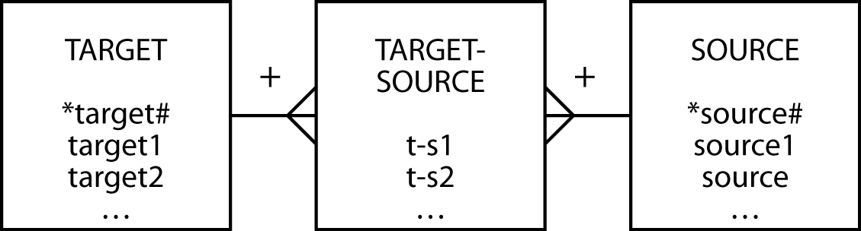
Divide Template
Find target1 appearing in all sources
select target1 from target where not exists (select * from source where not exists
(select * from target-source
where target-source.target# = target.target#
and target-source.source# = source.source#));

Slide 21
Recap
Introduced
Many to Many Relationship
Associative / Weak Entity
Three Table Join
exists
not exists
Divide

Slide 22
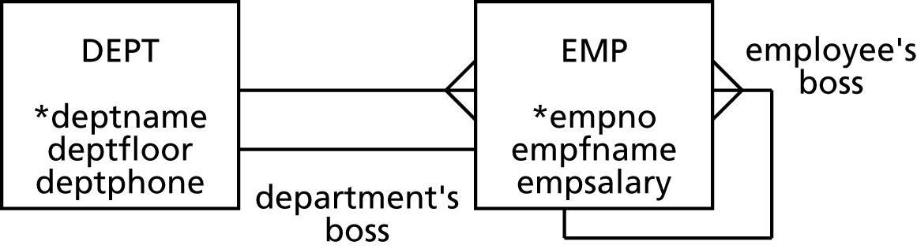
Next Class
One to One and Recursive Relationships (6)

